Slide 1
PIZZA SALES REPORT
JANURAY 2015 - December 2015
- Vikash singh

Slide 2
CONTENTS
01 Introduction
02 Data Overview
03 KPI’S
04 Sales Analysis
05 Customer Behaviour Analysis
06 Key Insights
07 Conclusion and Implications
08 Q&A

Slide 3
Introduction
Project Overview:
Conducted an in-depth analysis of pizza sales data to uncover key trends and insights.
Utilized Microsoft Excel for cleaning and transforming the data, SQL Server for querying the data and Power BI for creating interactive dashboards.
Objectives and Goals:
Sales Analysis: To understand sales performance across different pizza sizes, categories, and time periods.
Customer Behavior Analysis: To explore customer ordering patterns, preferences, and the relationship between order quantity and price.
Tools Used:
SQL Server
Power BI
PostgreSQL Server
Scope:
Data from January 2015 to December 2015.
Focused on providing actionable insights to drive decision-making and optimize sales strategies.

Slide 4
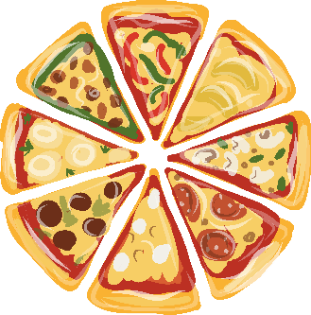
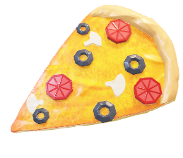
Descriptive Statistics
45 Unique
Pizzas
4 Pizzas
Category
supreme,
Chicken, Veg,Classic
5 Different
Pizza sizes R, M, L, X-L, XXL

Slide 5





KPI’S
$ 817.86K
Total Revenue
$ 38.31
Avg sell per order
49574
Total pizzas sold
21350
Total Orders
2.32
pizzas per order
Total revenue for
period from Jan 2015 – Dec 2015 is 817.86k dollars
Avg sell per order is for pizzas is
Of $ 38.31
Total Pizzas sold during a period are 49574
Total orders received in a year are 21350
We have sold 2.32 pizzas per order

Slide 6
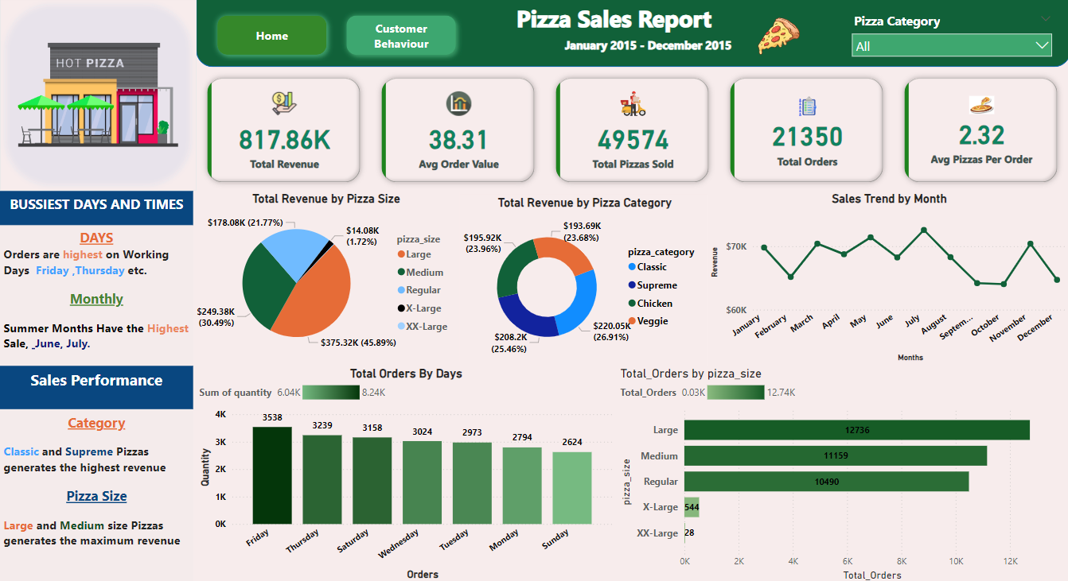
Sales Dashboard

Slide 7
Sales Analysis Insights
Total Revenue by Pizza Size:
Insight: Large and Medium pizzas generated the highest revenue, with Large pizzas contributing 45.89% of total sales.
Visual: A pie chart illustrating revenue distribution across different pizza sizes.
Total Revenue by Pizza Category:
Insight: The Classic and Supreme categories dominate the sales, contributing over 50% of the total revenue.
Visual: A donut chart showing revenue contributions by pizza category.
Sales Trend by Month:
Insight: Revenue peaks during the summer months (June, July) and Fridays and Thursdays are the busiest days.
Visual: A line graph showing monthly sales trends.
Orders by Day of the Week:
Insight: Weekdays, particularly Fridays and Thursdays, see the highest number of orders, while Sundays have the lowest.
Visual: A bar chart comparing the number of orders across different days of the week.

Slide 8
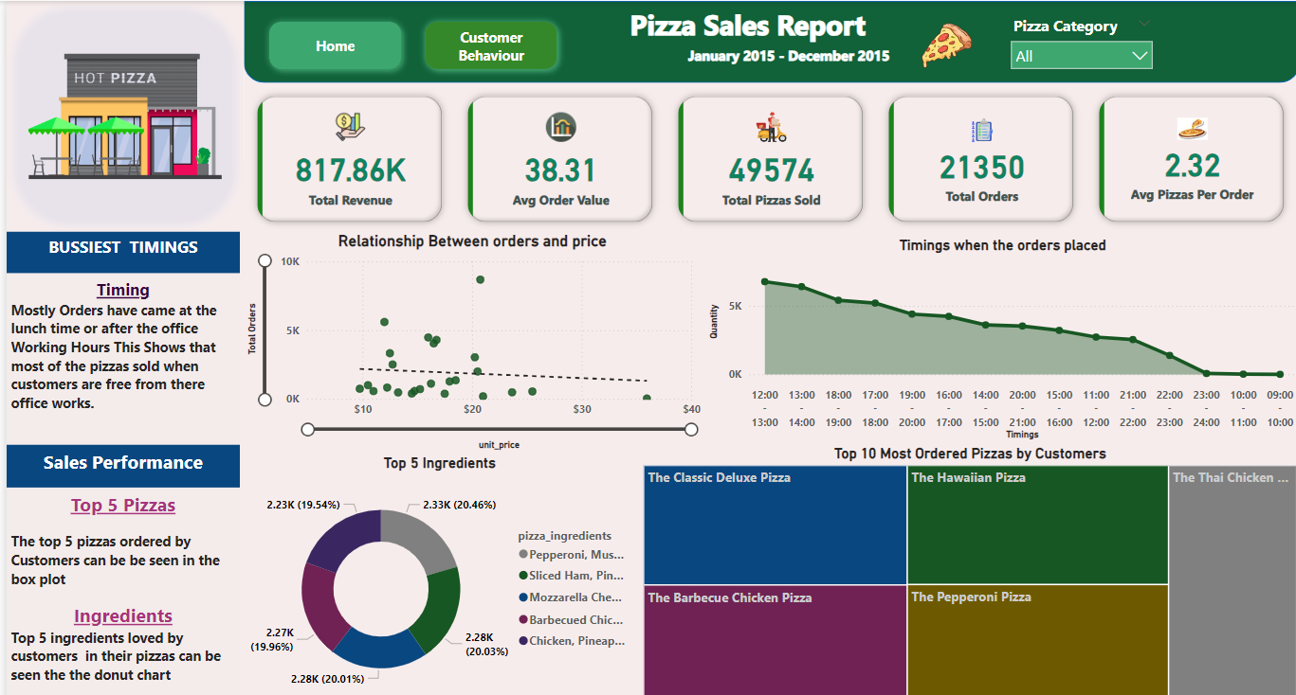
Customer Behavior Dashboard

Slide 9
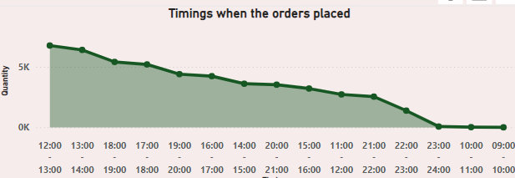
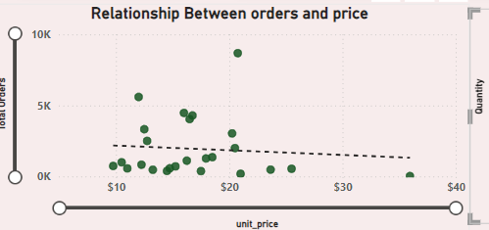
Customer Behavior Analysis Insights
Busiest Times for Orders:
Insight: Most orders are placed during lunch hours (12 PM - 2 PM) and dinner hours (6 PM - 8 PM), indicating peak times when customers prefer to order pizzas.
Visual: A line graph showing the distribution of orders across different times of the day.
Relationship between order and price:
Price Sensitivity: Most orders are concentrated between $10 and $20, indicating customer preference for this price range.
Decreasing Trend: As prices increase, the total number of orders tends to decrease, suggesting customers are less inclined to purchase higher-priced pizzas.

Slide 10
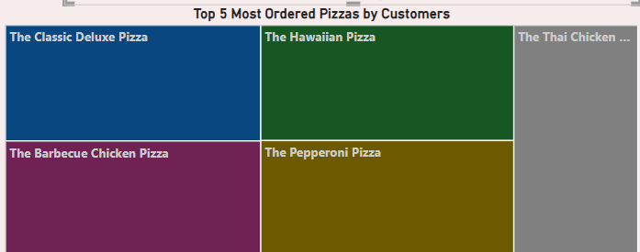
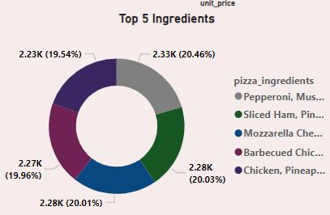
Customer Behavior Analysis Insights
Top 5 Ordered Pizzas:
Insight: The most popular pizzas include The Classic Deluxe, The Hawaiian Pizza, and The Barbecue Chicken Pizza. These pizzas are consistently among the top choices of customers.
Visual: A tree map showing the top 5 pizzas ordered by customers.
Ingredient Preferences:
Insight: Customers show a strong preference for pizzas with ingredients like Mozzarella Cheese, Pepperoni, and Barbecue Chicken, indicating the popular flavors and toppings.
Visual: A donut chart highlighting the top 5 ingredients loved by customers.

Slide 11
Conclusion
Seasonal and Weekly Sales Patterns: Sales peak during the summer months (June, July) and towards the end of the workweek (Fridays and Thursdays), indicating a strong season and weekly trend in pizza demand.
Popular Pizza Sizes and Price Sensitivity: Large and medium pizzas generate the most revenue, and there is a noticeable price among
customers, with mid-priced pizzas ($10-$20) being the most popular.
Implications
Targeted Marketing: Utilize the identified peak seasons and weekdays for promotional campaigns to maximize sales during these high-demand periods.
Pricing Strategy Optimization: Focus on mid-range pricing and explore flexible pricing strategies to attract customers, especially for higher-priced pizzas, without sacrificing profitability
Product Focus: Continue emphasizing large and medium pizzas in product offerings and promotions, while considering the introduction of customizable options based on popular ingredients.

Slide 12
Q&A
Any Questions ?

Slide 13
THANK YOU

